Slide 1

The Economics of Biocircular Agrifood Systems Innovations
Chris Barrett
Guest Lecture to
GDEV/PLSCI 3030/5030
November 17, 2025

Slide 2
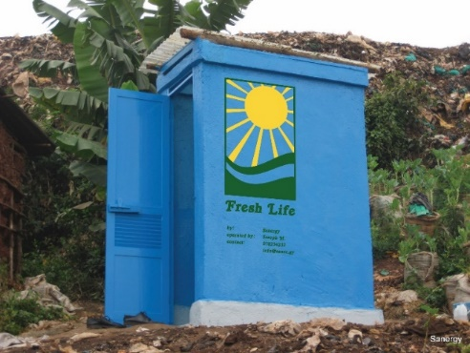
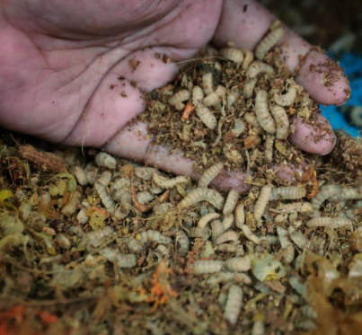
Biocircular AFS innovations
Exciting innovations harness circularity to address AF issues: recycle/reuse/repurpose waste streams
Especially promising for fertilizer (e.g., human/animal/ food waste) and feed (e.g., BSF larvae)
Photo credits: Sanergy, Alexander Mathys , Andrew Simons

Slide 3
Why does innovation matter?
What spurs rising, sustainable living standards?
Three possible sources:
Increased use of inputs (land, water, labor, capital) brings more output, but typically at diminishing rate. Implies reduced marginal returns to labor (i.e., lower real wages and higher poverty) and environmental degradation (X⁰ to X¹).
Increased efficiency in using existing inputs and technologies, commonly through extension (Y⁰ to Y¹). Schultz’s (1964) “poor but efficient” hypothesis suggests limits to this option.
Technological change/innovation increases output potential given same inputs. Requires diffusion of innovations to scale discoveries. Main long-term source of productivity/income growth for sustainable gains in living standards.
Output/person
New Production Possibility
Production Possibility
Y¹
Y⁰
Inputs/person
X⁰
X¹

Slide 4

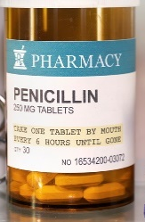
How does innovation arise?
Phase 1 (Discovery): Sources of technological change
Induced innovation model: private agents innovate so as to conserve relatively scarce/dear factors and to increase relatively valuable outputs. So ‘factor bias’ in tech change varies by region/crop/era (Hayami & Ruttan).
Strategically targeted investments by not-for-profit donors and governments: CGIAR, GAVI, etc.
Serendipity
Empirical evidence: induced innovation most important.
II turns on price signals, so easily distorted by policies or market failures or wealth effects.

Slide 5
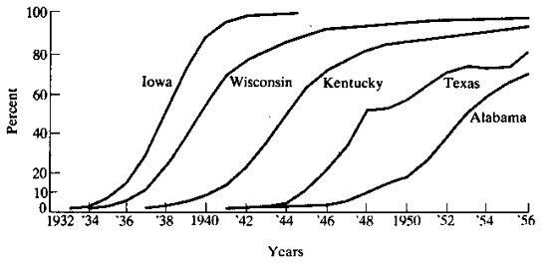
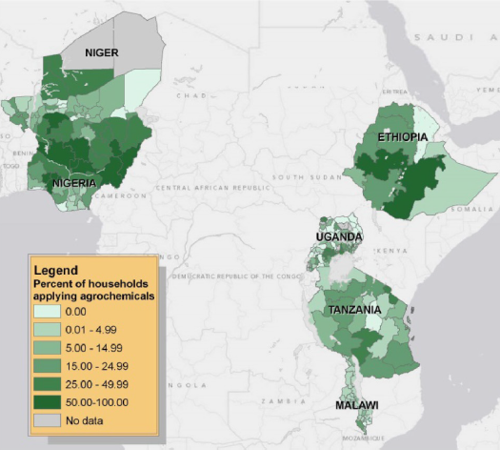
From discovery to diffusion
Phase 2 Diffusion of innovations
Standard diffusion pattern over time is logistic …
(Griliches, Econometrica, 1957 on hybrid corn in US)
Varies a lot among/within countries
(Sheahan and Barrett, Food Policy 2017)

Slide 6


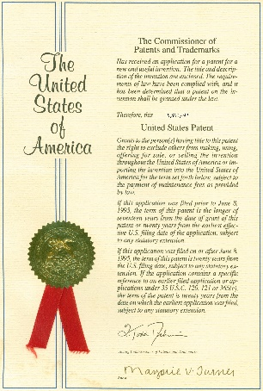
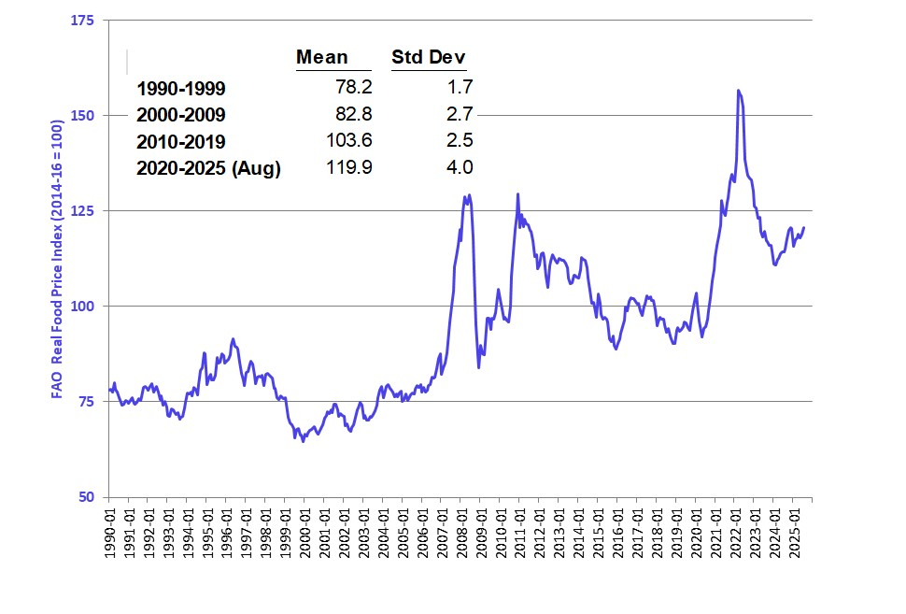
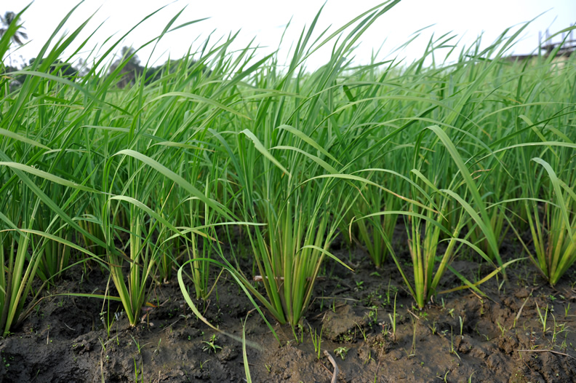
What impedes innovation?
Barriers to discovery:
1. Insufficient R&D investment
2. Intellectual property barriers
3. Information flow
Barriers to diffusion:
1. Information: extension, social networks
2. Profitability (over time)
3. Risk
4. Social acceptability

Slide 7
Biocircular AFS innovations
So how to promote diffusion of circular AFS tech?

Slide 8
Biocircular AFS innovations
Ethiopia example: bonechar fertilizer

Slide 9
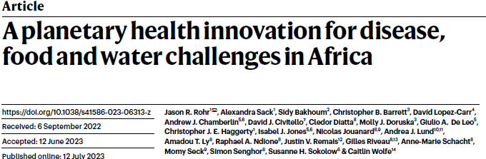
Biocircular AFS innovations
Senegal example: repurpose invasive aquatic vegetation

Slide 10
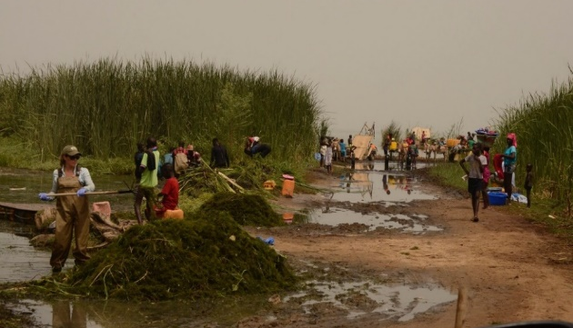
Biocircular AFS innovations
Harvest c. demersum.
Snails/infections (esp. S. mansoni) fell. Turn biomass into compost or livestock feed:
Private benefit/cost = [2.7,4.0]
Public benefit/cost = [3.1,8.8]

Slide 11
Agrifood systems urgently need innovation to boost productivity while reducing the water, land, and chemical footprint of food, feed and biofuels production.
Some circular methods seem very promising. Need to continue R&D and work on overcoming information, profitability, risk and social acceptability barriers to adoption.
Thanks for your time and attention!

